Slide 1

July 3 Videoconference
Narayanan Jayaraman
Alan Flury
Scheller College of Business

Slide 2
MGT6754 Business Fundamentals for Analytics Video Conference Call #8 Agenda
Entrepreneurial Finance Homework (Open July 6 8am, Close July 14, 11:59pm eastern)
Next Videoconference Call will be Thursday July 11, 7pm eastern
Entrepreneurial Finance, Topics 1 and 2

Slide 3
MGT6754 Business Fundamentals for Analytics Video Conference Call #8 Entrepreneurial Finance - Valuation
Considerations in Valuation
Qualitative
Quantitative
Industry Dynamics
Product / Service related
Organizational factors
Manufacturing or process
Legal or other
Comparables
Net Present Value Method
Venture Capital Method

Slide 4
Business Fundamentals for Analytics Video Conference Call #8 Happy Healthcare Problem
 | Private Health | Happy Healthcare | Community Health
 |  | ($MM)
Balance Sheet
Assets | 160 | 300 | 380
Long-Term Debt | 5 | 100 | 0
Net Worth | 80 | 120 | 175
Income Statement
Revenues | 350 | 420 | 850
EBITDA | 45 | 55 | 130
Net Income | 30 | 20.0 | 75.0
Market Data
Earnings per Share ($/share) | 3.00 | 0.67 | 2.14
Price-Earnings Ratio (times) | n/a | 21.0 | 14.5
Shares Outstanding (m) | 10 | 30 | 35
Number of Members | 500,000 | 600,000 | 1,100,000
Use of Public Market Comparables to Value Private Companies
Use Discount for Liquidity - 20 to 25 %
 | Happy Healthcare | Community Health | Average | Private Health Implied Value ($M)
Price-Earnings Ratio | 21.0 | 14.5 | 17.8 | 533
Market Value/EBITDA | 9.49 | 8.35 | 8.92 | 397
Market Value/Sales | 1.24 | 1.28 | 1.26 | 436
Market Value/Book Value of Equity | 3.52 | 6.21 | 4.86 | 389
Market Value/Member | 870 | 987 | 929 | 459
Public Firms
Price/Earnings Ratio
Price/EBIT as an alternative
Market Value of Equity/Sales
Market Value of Equity/Book Value of Equity
Private Firms
Internet -- Number of Subscribers
Biotechnology -- Number of Patents
Industry Specific Multiples

Slide 5
Business Fundamentals for Analytics Video Conference Call #8 Computation Details for Happy Healthcare Valuation
 | Happy Healthcare | Community Health
Market Value = EPS * P/E* Number of shares | .67*21*30=420m | 2.14*14.5*35=1,086
Enterprise Value = Market Value + Long term debt | 420 +100= 520 m | 1,086+0=1,086
Enterprise Value/Sales | 520/420=1.24 | 1,086/850=1.28
Enterprise Value/EBITDA | 520/55= 9.49 | 1086/130=8.35
Enterprise Value/Member | 520,000,000/600,000 =870 | 1,086,000,000/1,100,000 =987

Slide 6
Business Fundamentals for Analytics Video Conference Call #8 Valuation: NPV Method
CF_{t} = EBIT_{t} * (1-T) +Depr._{t} - CAPEX_{t} - ΔNWC_{t}
CF = Cash Flow
EBIT = Earnings Before Interest and Taxes
T = Corporate Tax Rate
DEPR = Depreciation
CAPEX= Capital Expenditures
ΔNWC = Increase in Net Working Capital
Terminal Value
CF_{T} * (1+g)
TV_{T} = ---------------------
r - g
Typically assume that the WC is zero year over year and that capex = depreciation
CF₁ CF₂ CF₃ CF_{T} + TV_{T}
NPV = ---- + ---- + ----- + …… +-----------
1+r. (1+r)^{2.} (1+r)^{3.} (1+r)^{T}
Notes:
_________________________________________________________________
_________________________________________________________________
_________________________________________________________________
_________________________________________________________________
_________________________________________________________________
_________________________________________________________________
_________________________________________________________________
_________________________________________________________________

Slide 7
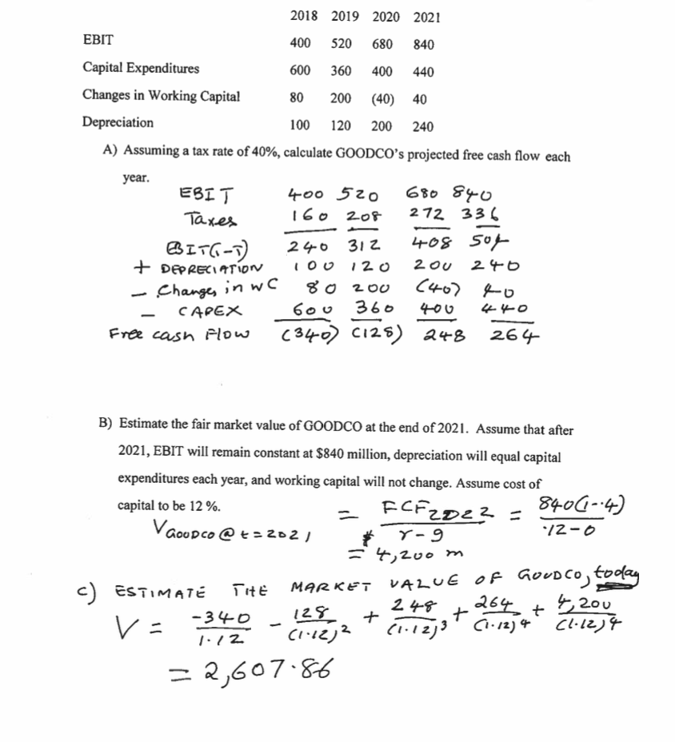
Business Fundamentals for Analytics Video Conference Call #8 Sample NPV Valuation Problem

Slide 8
Business Fundamentals for Analytics Video Conference Call #8 The Perpetuity Formula
A perpetuity is a constant stream of cash flows without end. Present Value of perpetuity = Constant cash flows / Discount rate
Example : Consider a perpetuity paying $100 per year. If the relevant discount rate is 8 percent, what is the value of the perpetuity today?
PV = 100/.08 = $1,250
A growing perpetuity is where the cash flows are increasing at a constant rate “g.” Present Value of growing perpetuity = Cash flow next year / (Discount rate –g) = Cash flow this year * (1+g) / (Discount rate –g). Note that the previous case is a special case of growing perpetuity with g =0 ]
Example: Popovich Corporation recently paid $3.00 dividend. The dividends are expected to raise 6 percent a year forever. The applicable discount rate is 11 percent. What is the price of the stock today?
Price today = 3 * (1.06)/ (.11-.06) = $ 63.60

Slide 9
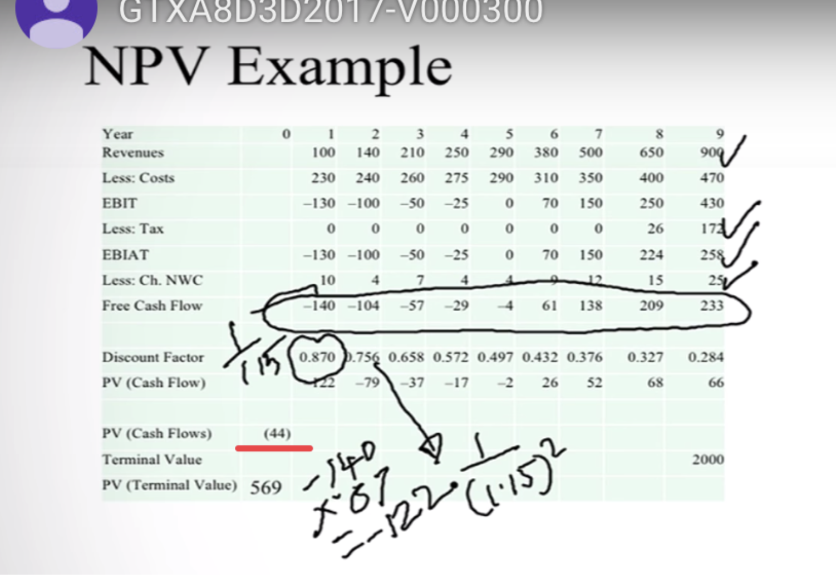
Business Fundamentals for Analytics Video Conference Call #8 Valuation: NPV Method Recap
Question from the Forum
Can You Explain How the Tax Carry Forward Affects FCF?

Slide 10
Business Fundamentals for Analytics Video Conference Call #8 Common Questions from Previous Forums
Based on the lessons we learn, it seems like the cost of debt is significantly lower than the cost of equity, which is a little bit counter intuitive to me. If a firm decides to take out many loans, then it will drive the cost of capital lower, hence making a lot of investment alternatives viable. On the other hand, if a firm decides to take fewer loans, the cost of capital is higher, and the investment alternatives will be less attractive compared to the cost of capital. It is counter intuitive to me because a company will actually end up paying for interest.
The FCF Formula FCF = EBIT (1-t) – capex +/- change in WC + depreciation
Why is the change in working capital important
What about interest (the I in EBIT)
In the last module you subtract out depreciation, calculated the taxes then added back the depreciation (for the NPV projects problems). In this module it looks like you just add back in the depreciation but don’t initially subtract it. Why are the two modules different?
What is the logic behind the terminal value calculation? Which years earning should be used (lets say n = the exit year). Hey all, I am just curious, can someone explain the theory behind subtracting the growth rate from the WACC in the denominator of the terminal value calculation? I tried searching Google for an explanation, but the sites I've checked have just indicated how to calculate the terminal value, not provided an explanation of why it is calculated that way. I'm just trying to understand the theory so I can hopefully better understand and remember the formula.

Slide 11
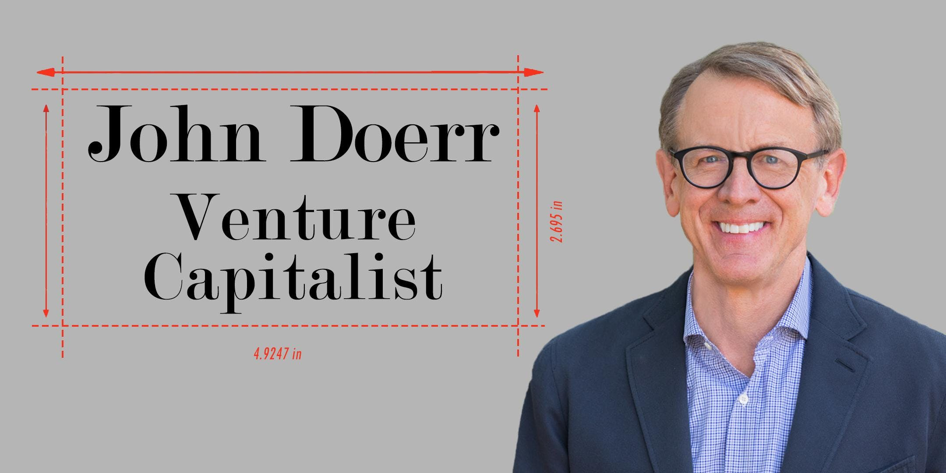
Business Fundamentals for Analytics Video Conference Call #8 Valuation: VC Method
Commonly used. Uses a multiple at a time in future when the firm is expected to have achieved positive cash flows and/or earnings.
This “Terminal Value” is discounted back using discount rates of 40% to 75%.
If the company’s discounted terminal value is $10 million, and the VC is providing $ 5 million, she will want 50% of the company.
This assumes no dilution.
A four step procedure is used.
Notes:
_________________________________________________________________
_________________________________________________________________
_________________________________________________________________
_________________________________________________________________
_________________________________________________________________
_________________________________________________________________
_________________________________________________________________
_________________________________________________________________

Slide 12
Business Fundamentals for Analytics Video Conference Call #8 Valuation: VC Method
1) Terminal Value is usually calculated using a multiple.
2) The discounted terminal value (DTV) obtained by :
Terminal Value
Discounted Terminal Value = ------------------
(1 + Target Rate) ^{years}
3) Investment
Required Final % Ownership = -------------------
DTV
Notes:
_________________________________________________________________
_________________________________________________________________
_________________________________________________________________
_________________________________________________________________
_________________________________________________________________
_________________________________________________________________
_________________________________________________________________
_________________________________________________________________

Slide 13
Business Fundamentals for Analytics Video Conference Call #8 Valuation: VC Method -- Questions from the Forum
4) Venture-backed companies commonly receive multiple
rounds of financing, followed by an IPO.
Retention Ratio quantifies the expected dilutive effect of
future rounds of financing on the VC’s ownership.
Consider a firm intends one more financing round, in which share representing additional 25% of the firm’s equity will be sold, and then sell additional 30% of the firm at the time of the IPO.
If the VC owns 10% today, after financings her stake will be 10/(1+.25)/(1+.3)=6.15%.
Retention Ratio = 6.15/10=61.5%
Notes:
_________________________________________________________________
_________________________________________________________________
_________________________________________________________________
_________________________________________________________________
_________________________________________________________________
_________________________________________________________________
_________________________________________________________________
_________________________________________________________________

Slide 14
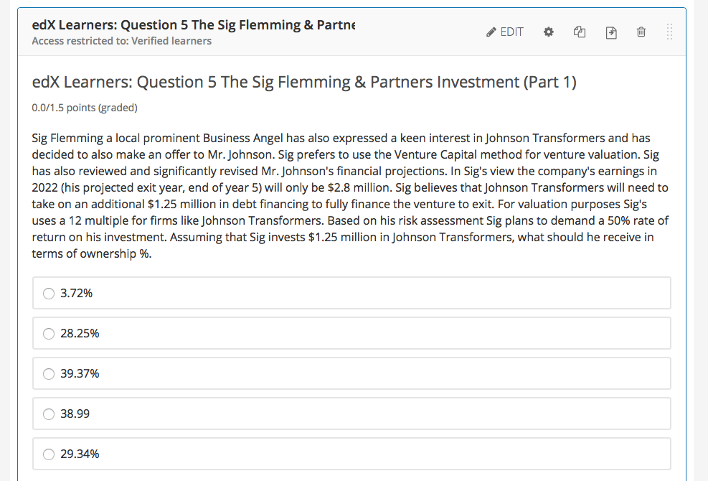
Business Fundamentals for Analytics Video Conference Call #8 Sample VC Method Problem: Sig Fleming
Valuation = ($2.8m*12)/(1.5)^5
= 33.6/7.594 = $4.425m
Sig’s ownership % = $1.25m/$4.425m
= 28.25%

Slide 15
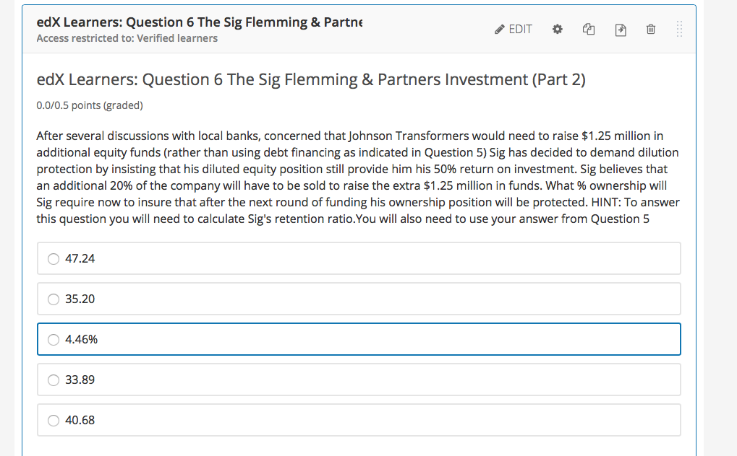
Business Fundamentals for Analytics Video Conference Call #8 Sample VC Method Problem: Sig Flemming
Sig’s Retention Ratio = 1/1.2
= .8333
Sig’s % = 28.25/.8333
= 33.90

Slide 16
Business Fundamentals for Analytics Video Conference Call #10 Valuation: VC Method – Common Questions from Previous
In valuing a firm using the VC Method: Where does the multiple come from? Where does “r” come from? Is it just the investor required rate of return. Why Professor Jayaraman gives two different ranges of ratios for VC's discount rate (in the videos)? One is 40%- 75%; the other one is 30%- 50%. Which one is correct?
Please explain the concept of Pre- and Post Money. Is Post Money always equal to the discounted terminal value? Why is the new investment considered to be included in the Post Money valuation?
When shares are given to the new investor are new shares issued or are existing shares just reallocated based on ownership percentages.
If the entrepreneur needs additional rounds of funding, how can they resell the equity that they sold to the first investor to a second investor? in other words, how do these additional rounds of funding dilute the percentage owned by the initial investor.

Slide 17
Business Fundamentals for Analytics Video Conference Call #8 Valuation: Comparison of Valuation Methods
Strength Weaknesses
_____________________________________________________________________________
Comparable Quick to use Private companies
Simple to understand comparable difficult
Commonly used to find
Market based If public company
comparables use
liquidity discount
_____________________________________________________________________________
Discounted Cash Theoretically Sound Cash flows difficult
Flow to estimate
WACC assumes constant
capital structure
Sensitive to terminal
growth assumptions
______________________________________________________________________________
Venture Capital Quick to use Relies on terminal value
Simple to understand from other methods
Commonly used Large discount rates

